Slide 1

Getting Started With JenKins

Slide 2
Objectives
Installing Jenkins.
Prerequisites.
Installation platforms.
Post-Installation setup wizard.
Using Jenkins.
Pipeline.

Slide 3
Installing Jenkins
Jenkins is typically run as a standalone application in its own process with the built-in Java servlet container/application server (Jetty).
Jenkins can also be run as a servlet in different Java servlet containers such as Apache Tomcat or GlassFish.

Slide 4
Prerequisites
Minimum hardware requirements:
256 MB of RAM.
1 GB of drive space (although 10 GB is a recommended minimum if running Jenkins as a Docker container).
Recommended hardware configuration for a small team:
1 GB+ of RAM
50 GB+ of drive space
Software requirements:
Java 8 - either a Java Runtime Environment (JRE) or a Java Development Kit (JDK) is fine Note: This is not a requirement if running Jenkins as a Docker container.

Slide 5
Installation Platforms

Slide 6
Docker
Docker is a platform for running applications in an isolated environment called a "container" (or Docker container). Applications like Jenkins can be downloaded as read-only "images" (or Docker images), each of which is run in Docker as a container.
A Docker container is in effect a "running instance" of a Docker image. From this perspective, an image is stored permanently more or less (i.e. insofar as image updates are published), whereas containers are stored temporarily.
Docker’s fundamental platform and container design means that a single Docker image (for any given application like Jenkins) can be run on any operating system (e.g. macOS, Linux and Windows) which is also running Docker.

Slide 7
Installing Docker
To install Docker on your operating system, visit the Docker website and navigate to Get Docker at the top of their site to begin accessing the Docker download that is suitable for your operating system. Follow the installation instructions on their website.

Slide 8
Downloading and running Jenkins in Docker
The recommended Docker image to use is the jenkinsci/blueocean image (from the Docker Hub repository). This image contains the current Long-Term Support (LTS) release of Jenkins (which is production-ready) bundled with all Blue Ocean plugins and features. This means that you do not need to install the Blue Ocean plugins separately.
Note
A new jenkinsci/blueocean image is published each time a new release of Blue Ocean is published. You can see a list of previously published versions of the jenkinsci/blueocean image on the tags page.
There are also other Jenkins Docker images you can use (accessible through jenkins/jenkins on Docker Hub). However, these do not come with Blue Ocean,which would need to be installed via the Manage Jenkins > Manage Plugins page in Jenkins. Read more about this in Getting started with Blue Ocean.

Slide 9
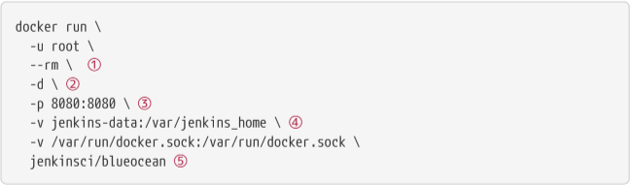
On macOS and Linux
Open up a terminal window.
Download the jenkinsci/blueocean image and run it as a container in Docker using the following docker run command:
Proceed to the Post-installation setup wizard.

Slide 10
( Optional ) Automatically removes the Docker container (which is the instantiation of the jenkinsci/blueocean image below) when it is shut down. This keeps things tidy if you need to quit Jenkins.
( Optional ) Runs the jenkinsci/blueocean container in the background (i.e. "detached" mode) and outputs the container ID. If you do not specify this option, then the running Docker log for this container is output in the terminal window.
Makes (i.e. "publishes") port 8080 of the jenkinsci/blueocean container to port 8080 on the host machine. The 1st number represents the port on the host while the 2nd represents the container’s port. Therefore, if you specified -p 49001:8080 for this option, you would be accessing Jenkins on your host machine through port 49001.
Maps the /var/jenkins_home directory in the container to the Docker volume with the name jenkins-data. If this volume does not exist, then this docker run command will automatically create the volume for you.
The jenkinsci/blueocean Docker image itself. If this image has not already been downloaded, then this docker run command will automatically download the image for you. Furthermore, if any updates to this image were published since you last ran this command, then running this command again will automatically download these published image updates for you.

Slide 11
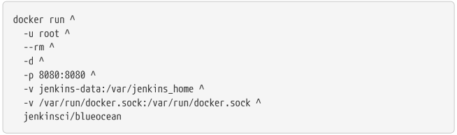
On Windows
Open up a command prompt window.
Download the jenkinsci/blueocean image and run it as a container in Docker using the following docker run command:
Proceed to the Post-installation setup wizard.

Slide 12
Accessing the Jenkins/Blue Ocean Docker container
If you have some experience with Docker and you wish or need to access the jenkinsci/blueocean container through a terminal/command prompt using the docker exec command, you can add an option like --name jenkins-blueocean (with the docker run above), which would give the jenkinsci/blueocean container the name "jenkins-blueocean".
This means you could access the container (through a separate terminal/command prompt window) with a docker exec command like:
docker exec -it jenkins-blueocean bash

Slide 13
Accessing the Jenkins console log through Docker logs
You can access the Jenkins console log through the Docker logs of the jenkinsci/blueocean container using the following command:
docker logs <docker-container-name>
Your <docker-container-name> can be obtained using the docker ps command. If you specified the --name jenkins-blueocean option in the docker run Command, then you can simply use the docker logs command:
docker logs jenkins-blueocean

Slide 14
WAR file
The Web application ARchive (WAR) file version of Jenkins can be installed on any operating system or platform that supports Java.
To download and run the WAR file version of Jenkins:
Download the latest stable Jenkins WAR file to an appropriate directory on your machine.
Open up a terminal/command prompt window to the download directory.
Run the command java -jar jenkins.war.
Browse to localhost:8080 and wait until the Unlock Jenkins page appears.
Continue on with the Post-installation setup wizard below.

Slide 15
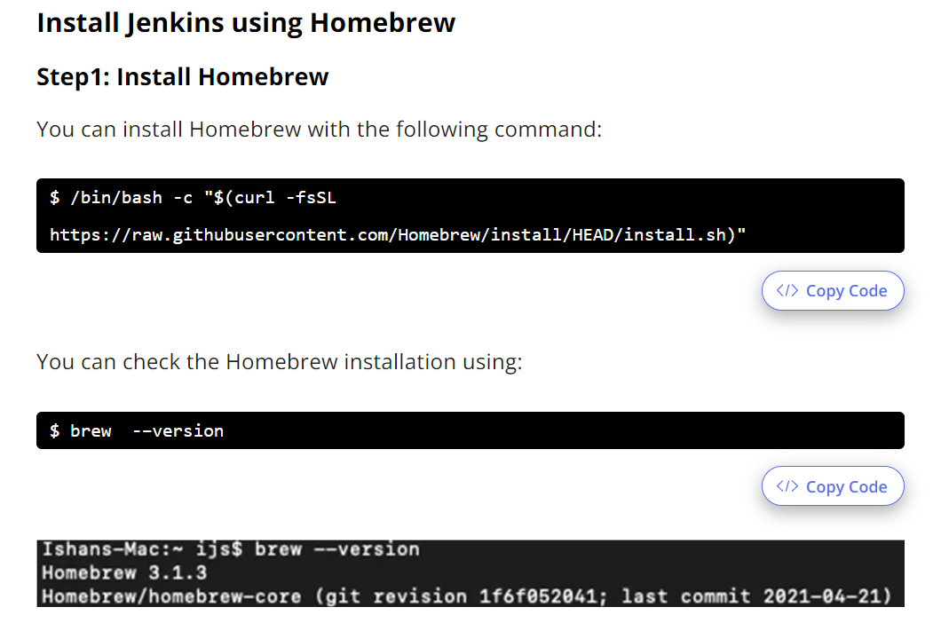
Mac Installation

Slide 16
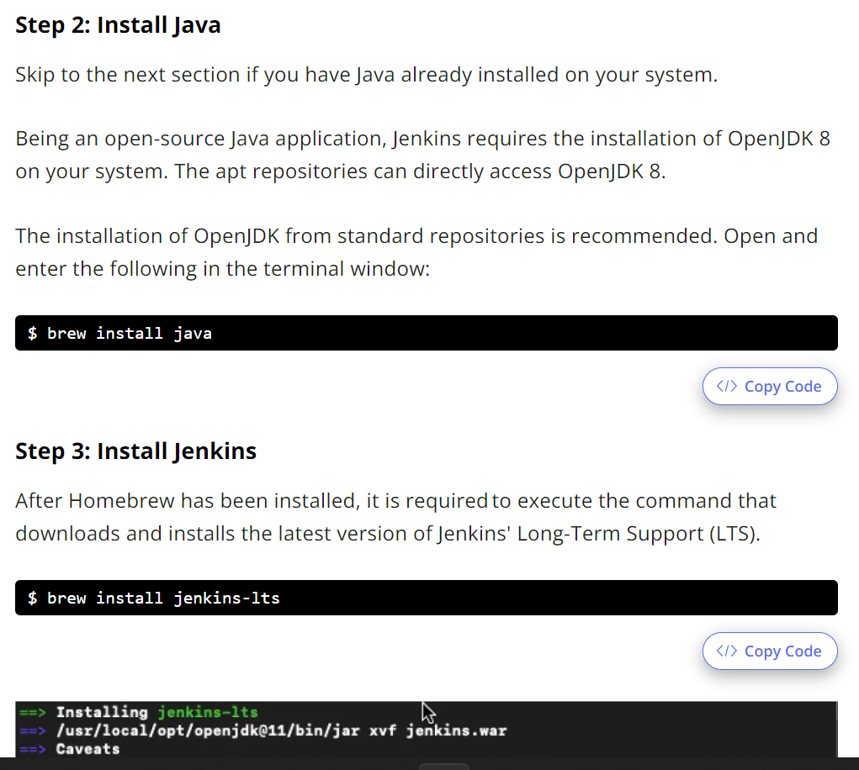

Slide 17
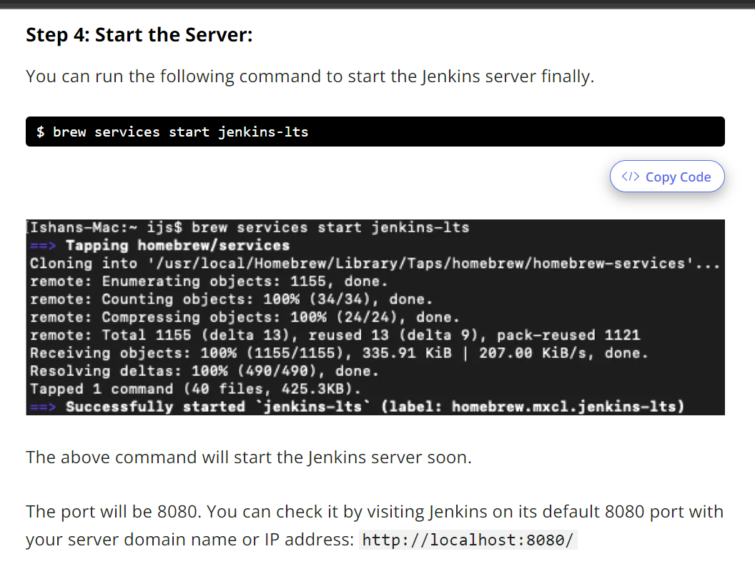

Slide 18
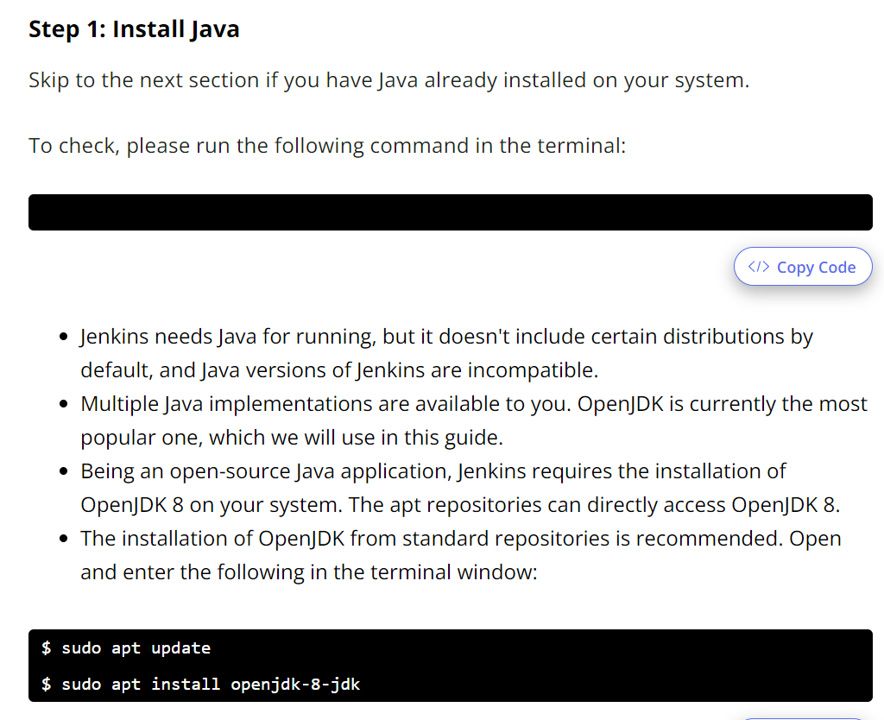
Ubuntu Installation

Slide 19
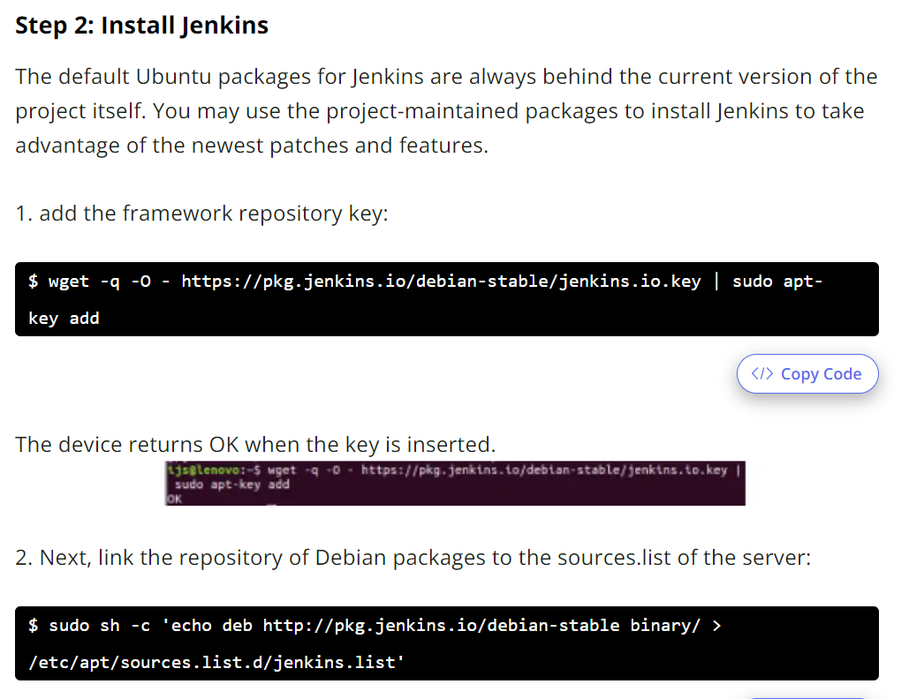

Slide 20
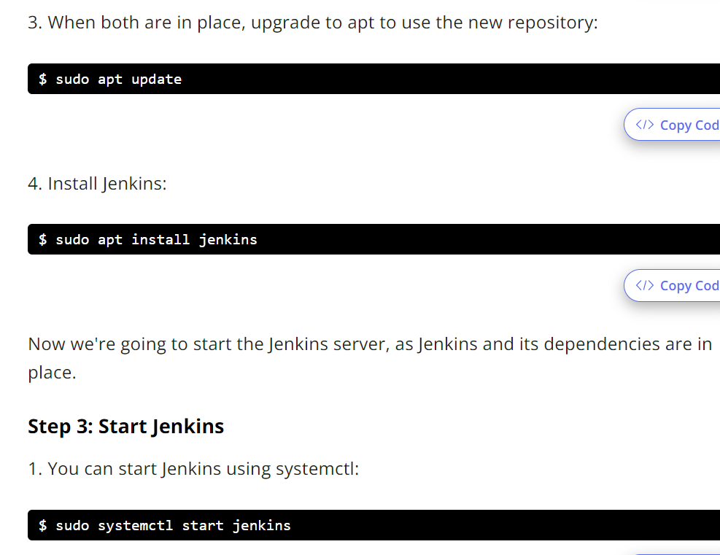

Slide 21
Windows Installation
Windows
install from the website, using the installer:
• Download the latest package
• Open the package and follow the instructions

Slide 22
Solaris, OmniOS, SmartOS, and other siblings
Generally it should suffice to install Java 8 and download the jenkins.war and run it as a standalone process or under an application server such as Apache Tomcat.
• Headless JVM and fonts: For OpenJDK builds on minimalized-footprint systems, there may be issues running the headless JVM, because Jenkins needs some fonts to render certain pages.

Slide 23
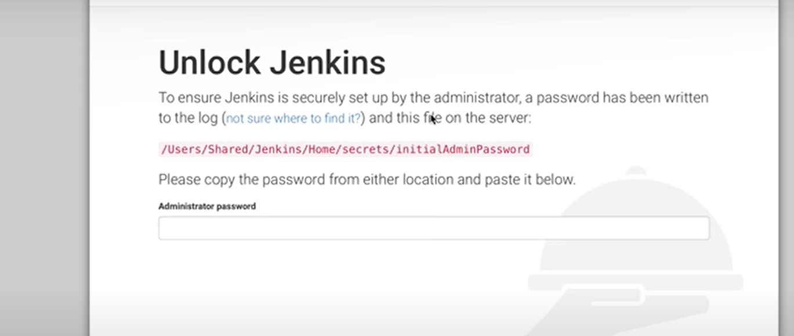
Unlocking Jenkins

Slide 24
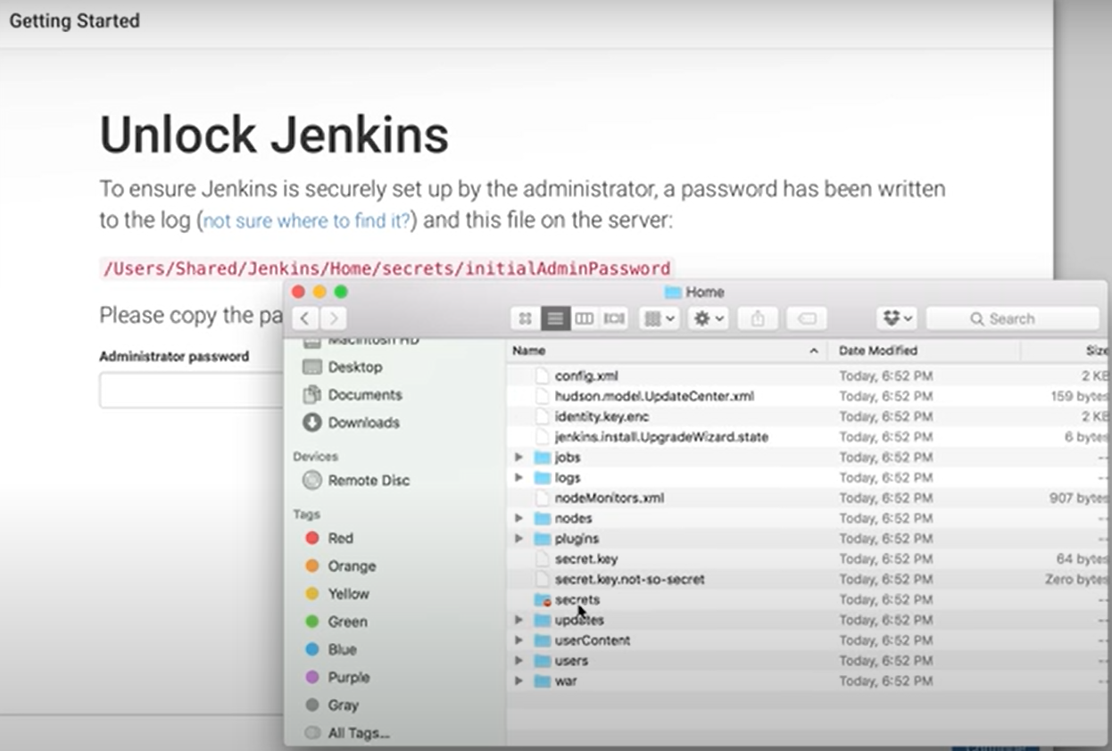

Slide 25
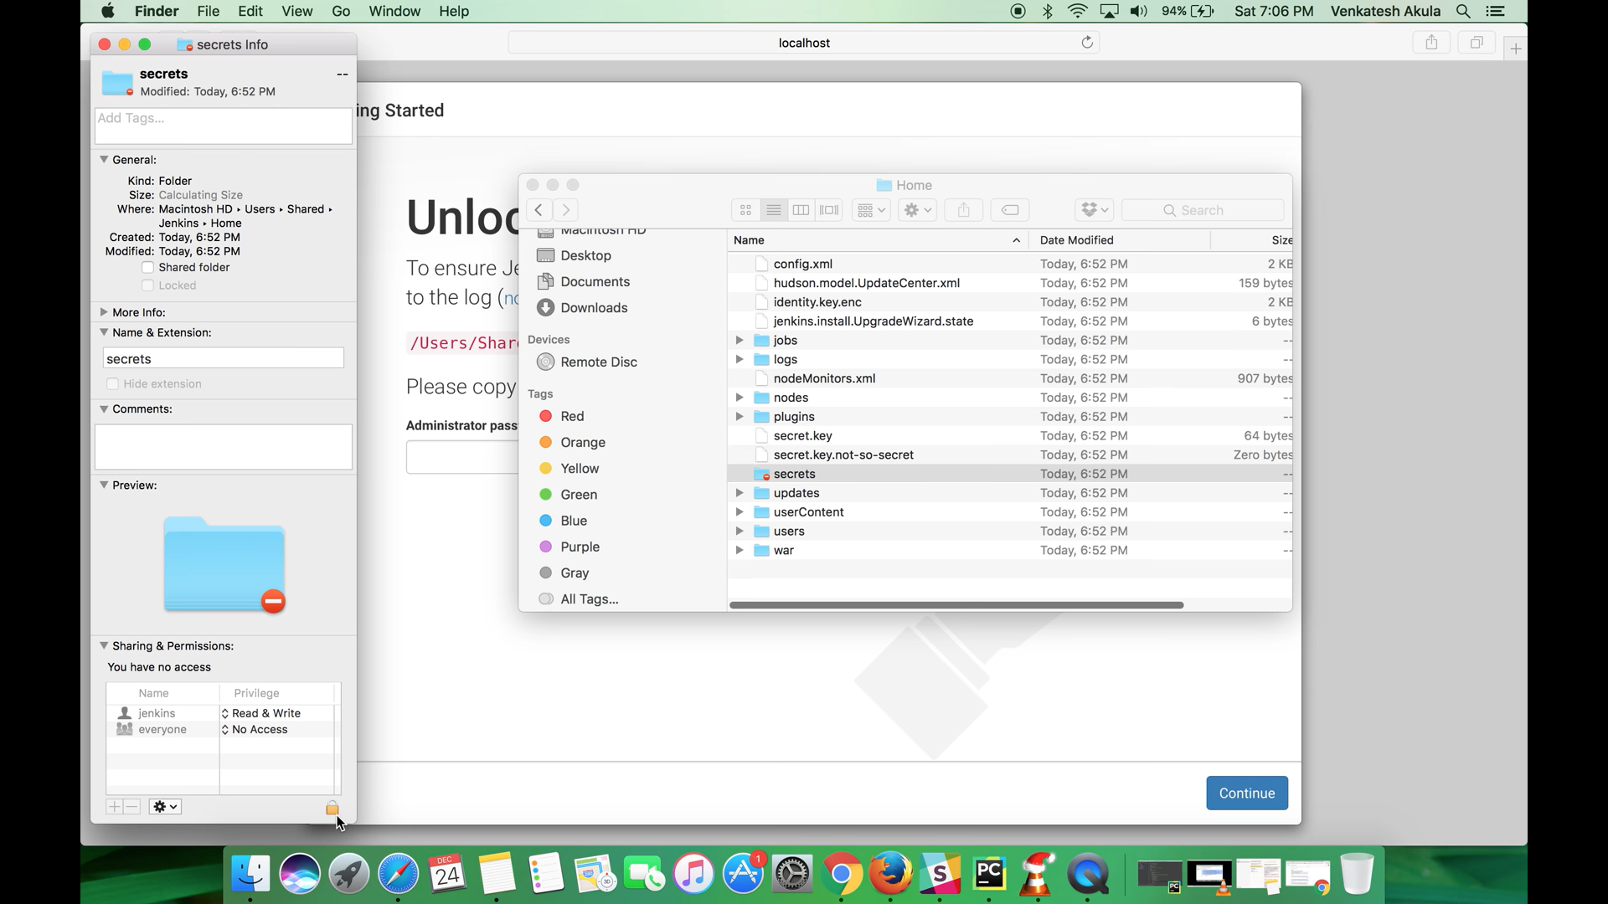

Slide 26
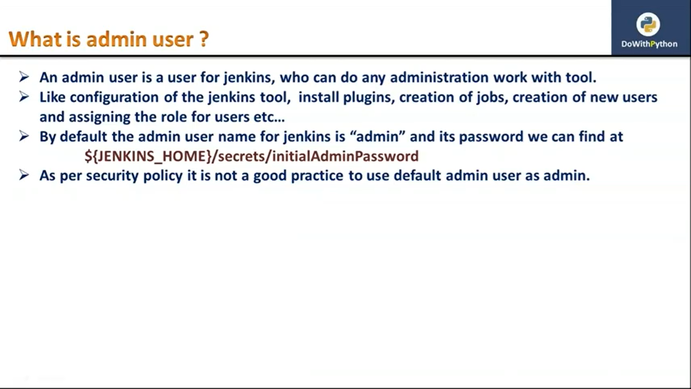
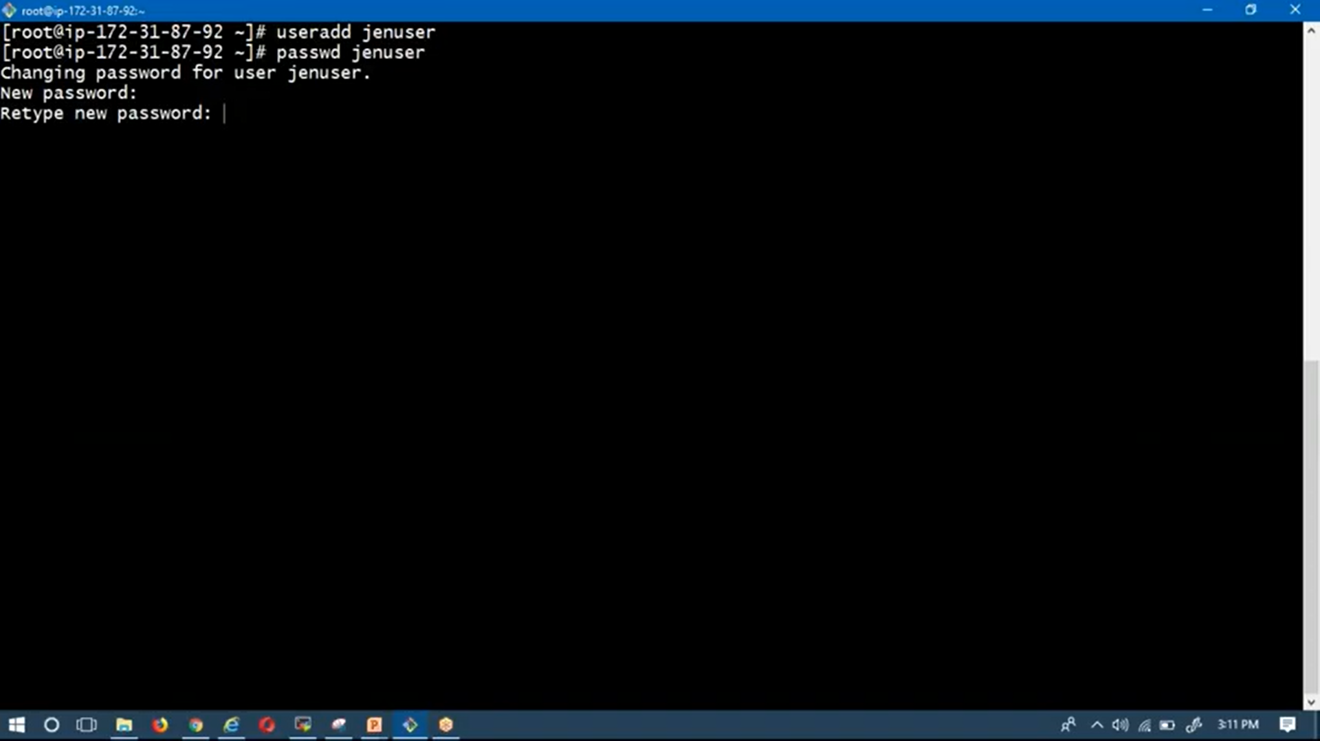

Slide 27
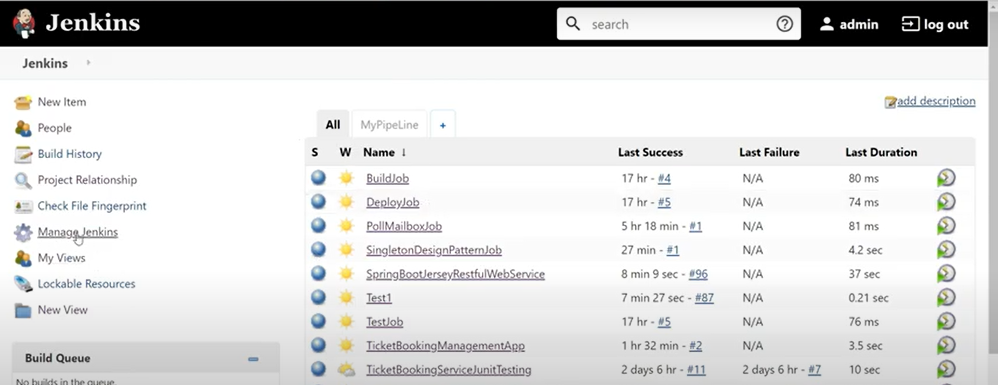

Slide 28
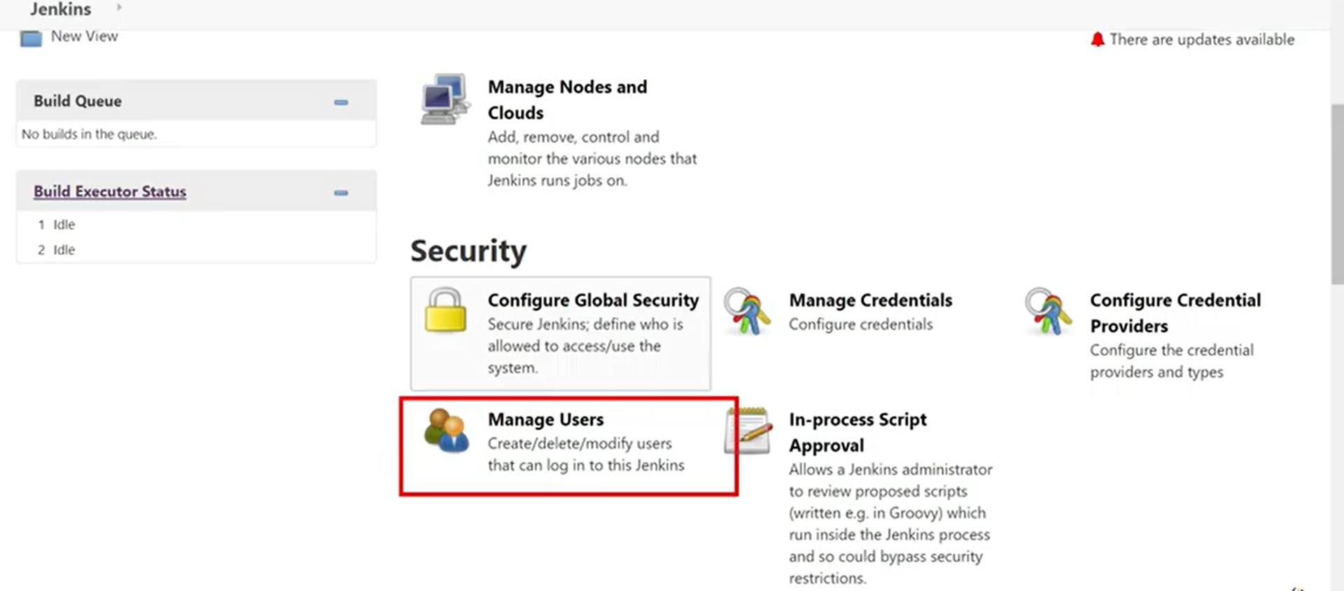

Slide 29
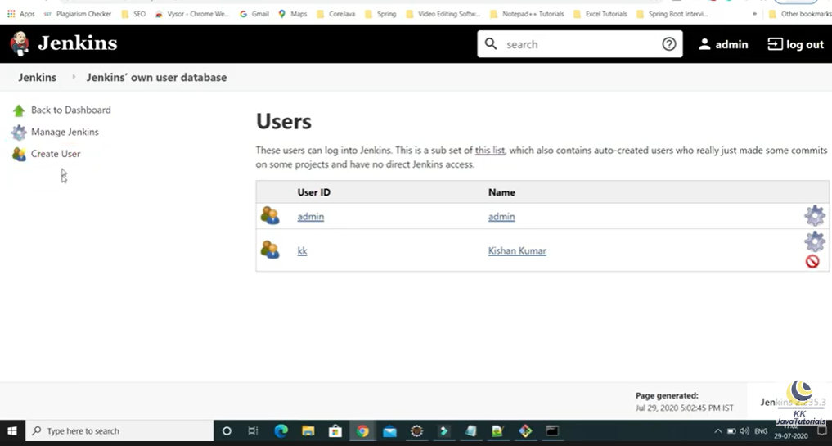

Slide 30
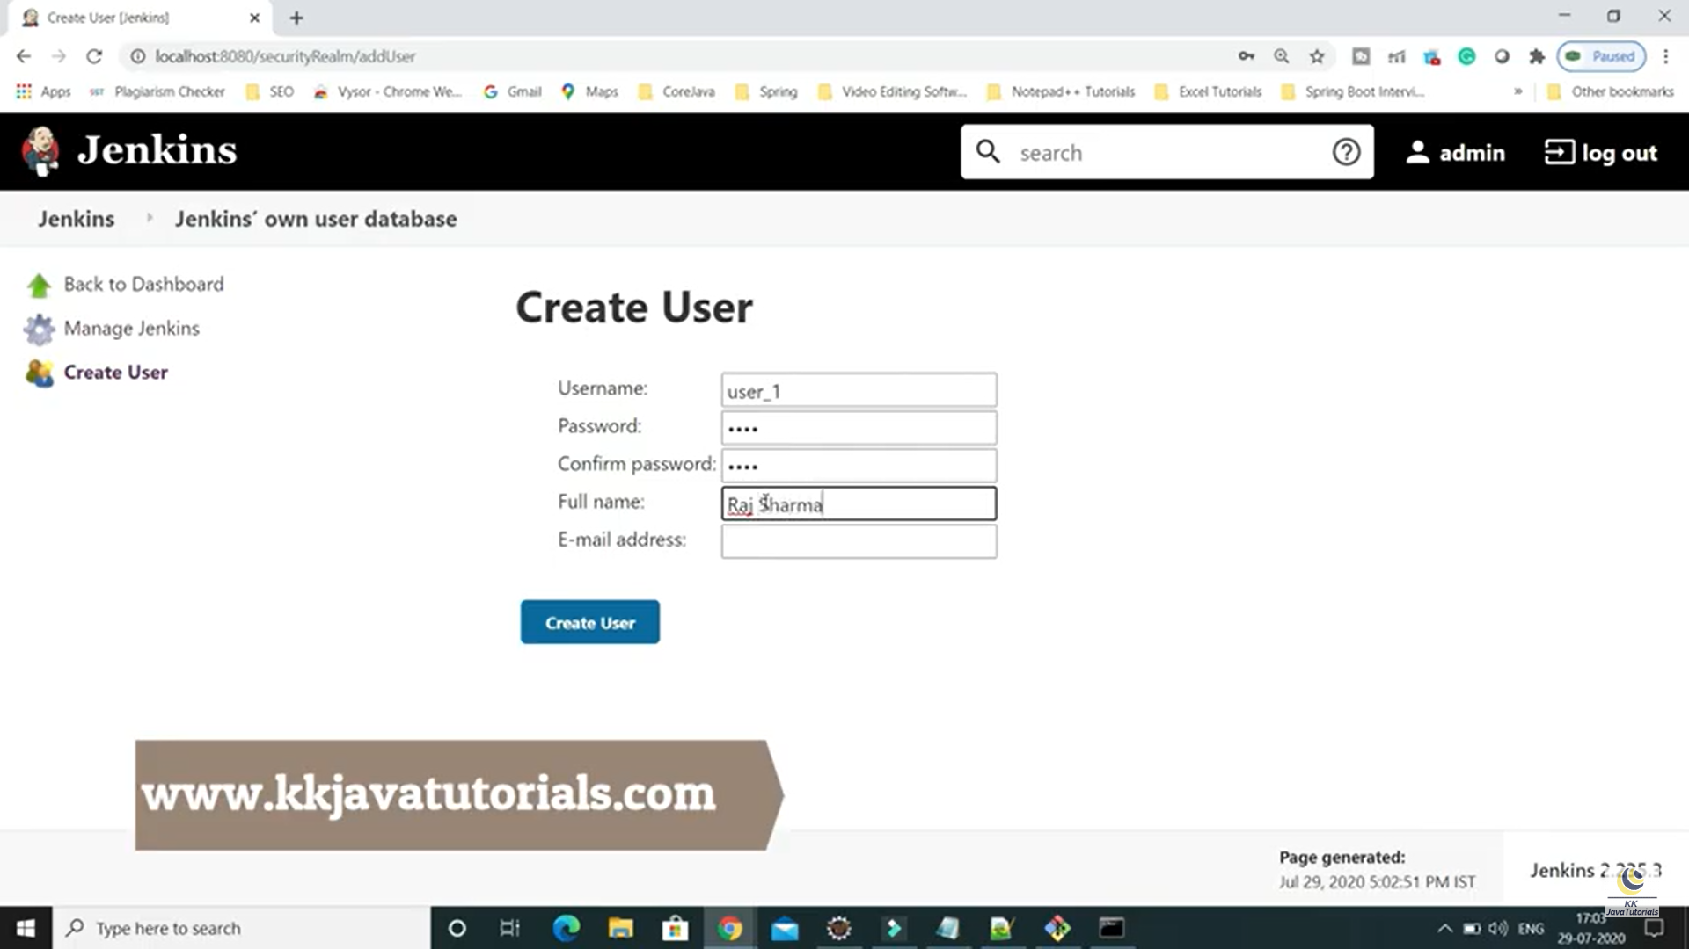

Slide 31
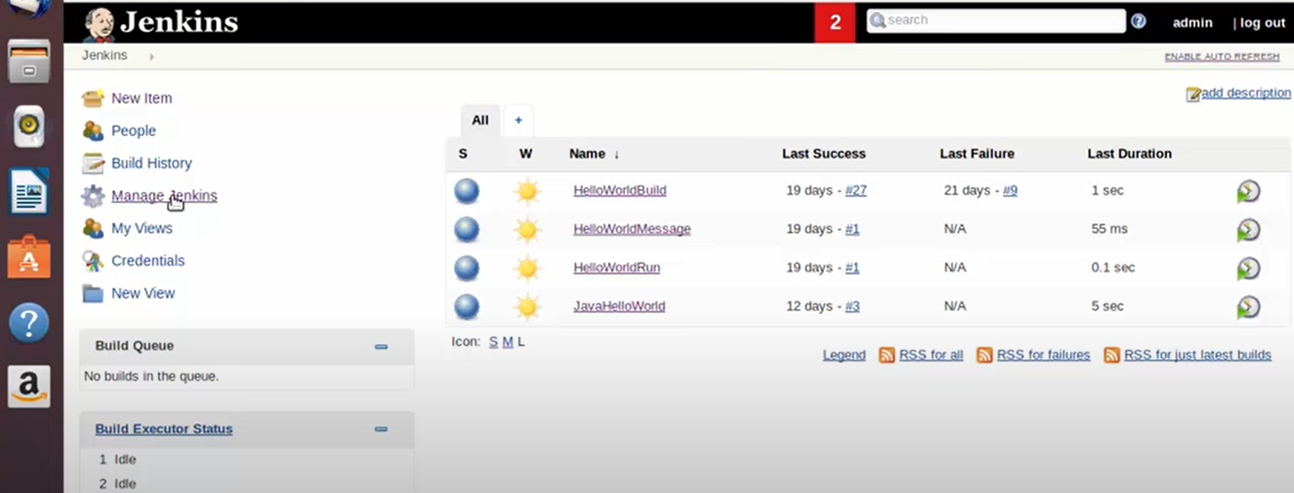
Installing Plugins

Slide 32
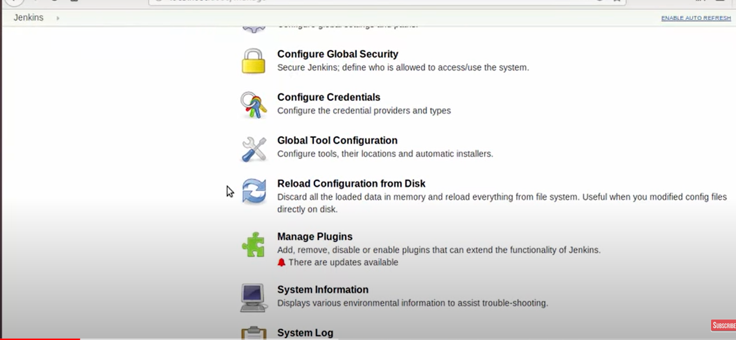

Slide 33
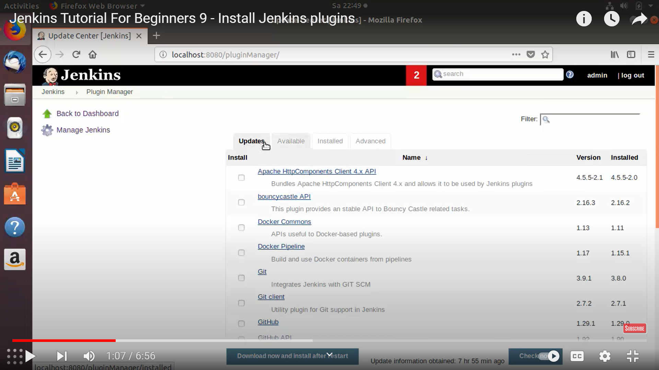

Slide 34

Pipeline
All aspects of Jenkins Pipeline, from running Pipelines to writing Pipeline code, and even extending Pipeline itself
Intended to be used by Jenkins users of all skill levels

Slide 35
What is Jenkins Pipeline?
Jenkins Pipeline (or simply "Pipeline" with a capital "P") is a suite of plugins which supports implementing and integrating continuous delivery pipelines into Jenkins
A continuous delivery pipeline is an automated expression of your process for getting software from version control right through to your users and customers
Pipeline provides an extensible set of tools for modeling simple-to-complex delivery pipelines "as code" via the DSL syntax

Slide 36
Benefits
Automatically create Pipelines for all Branches and Pull Requests
Code review/iteration on the Pipeline
Audit trail for the Pipeline
Single source of truth [3:en.wikipedia.org/wiki/Single_Source_of_Truth] for the Pipeline, which can be viewed and edited by multiple members of the project

Slide 37
Syntax
// Declarative //
pipeline {
agent any ---------1
stages {
stage('Build') { ----------2
steps { -----------3
sh 'make' ------------4
}
}
stage('Test'){
steps {
sh 'make check'
junit 'reports/**/*.xml' -----------5
}
}
stage('Deploy') {
steps {
sh 'make publish'
}
}
}
}
// Script //
node {
stage('Build') {
sh 'make'
}
stage('Test') {
sh 'make check'
junit 'reports/**/*.xml'
}
stage('Deploy') {
sh 'make publish'
}
}

Slide 38
Why Pipeline?
Jenkins is, fundamentally, an automation engine which supports a number of automation patterns.
Users can take advantage of the many features of Pipeline:
Code
Durable
Pausable
Versatile
Extensible

Slide 39
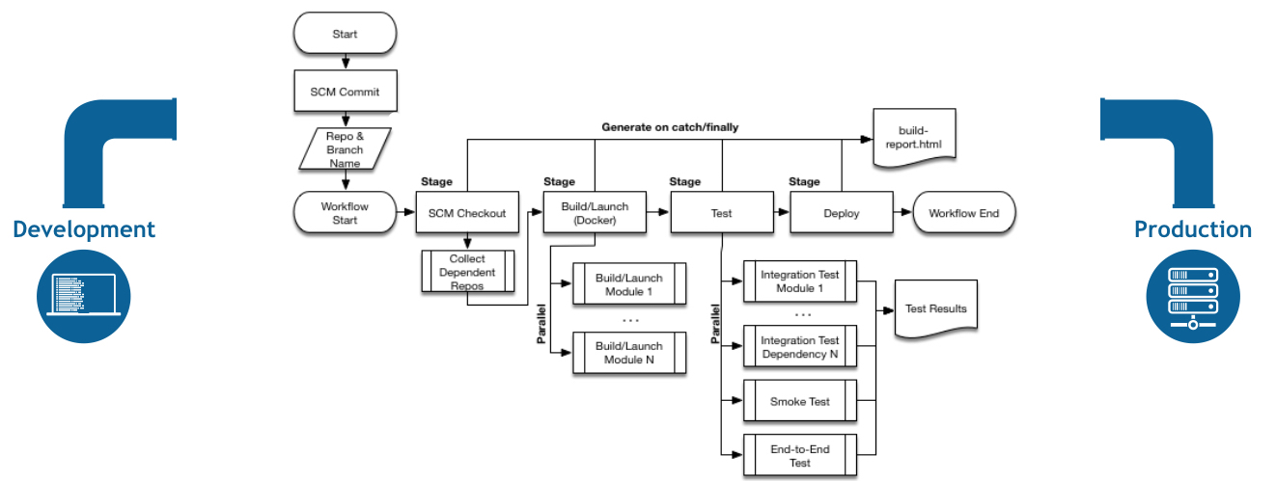
Flowchart

Slide 40
Pipeline Terms
1. Step:
Example, to execute the shell command make use the sh step: sh 'make'
2. Node: Node does two things
1. Schedules the steps contained within the block to run by adding an item to the Jenkins queue. As soon as an executor is free on a node, the steps will run
2. Creates a workspace (a directory specific to that particular Pipeline) where work can be done on files checked out from source control
3. Stage:
Example: "Build", "Test", and "Deploy"

Slide 41
Getting Started with Pipeline
Jenkins Pipeline is a suite of plugins which supports implementing and integrating continuous delivery pipelines into Jenkins
Pipeline provides an extensible set of tools for modeling simple-to-complex delivery pipelines "as code" via the Pipeline DSL
Some of the key concepts to Jenkins Pipeline and help introduce the basics of defining and working with pipelines inside of a running Jenkins instance.

Slide 42

Prerequisites
To use Jenkins Pipeline, you will need:
Jenkins 2.x or later (older versions back to 1.642.3 may work but are not recommended)
Pipeline plugin [8: Pipeline plugin]
To learn how to install and manage plugins, consult Managing Plugins

Slide 43

Defining a pipeline.
Defining a Pipeline in the Web UI
Defining a Pipeline in SCM (Source Code Managment)
Built-in Documentation
Snippet Generator
Global Variable Reference
Further Reading
Additional Resources

Slide 44
Defining a Pipeline
a pipeline is a collection of events or jobs which are interlinked with one another in a sequence.
Pipeline is a collection of jobs or events that brings the software from version control into the hands of the end users by using automation tools. It is used to incorporate continuous delivery in our software development workflow.
A basic Pipeline can be created in either of the following ways:
• By entering a script directly in the Jenkins web UI.
• By creating a Jenkinsfile which can be checked into a project’s source control repository.
It’s generally considered best practice to define the Pipeline in a Jenkinsfile which Jenkins will then load directly from source control.

Slide 45
Defining a Pipeline in the Web UI
To create a basic Pipeline in the Jenkins web UI, follow these steps:
• Click New Item on Jenkins home page.

Slide 46
• Enter a name for your Pipeline, select Pipeline and click OK.

Slide 47
• In the Script text area, enter a Pipeline and click Save.
• Click Build Now to run the Pipeline.

Slide 48
• Click #1 under "Build History" and then click Console Output to see the full output from the Pipeline.
This example shows a successful
run of a basic Pipeline created in the
Jenkins web UI, using two steps.
// Script //
node { ①
echo 'Hello World' ②
}
// Declarative not yet implemented //
① node allocates an executor and workspace in the Jenkins environment.
② echo writes simple string in the Console Output.

Slide 49
Defining a Pipeline in SCM (Source Code Managment)
Complex Pipelines are hard to write and maintain within the text area of the Pipeline configuration page. To make this easier, Pipeline can also be written in a text editor and checked into source control as a Jenkinsfile which Jenkins can load via the Pipeline Script from SCM option.
To do this, select Pipeline script from SCM when defining the Pipeline.
With the Pipeline script from SCM option selected, we do not enter any Groovy code in the Jenkins UI; we just indicate by specifying a path where in source code we want to retrieve the pipeline from. When we update the designated repository, a new build is triggered, as long as the Pipeline is configured with an SCM polling trigger.
The first line of a Jenkinsfile should be #!/usr/bin/env groovy [12:en.wikipedia.org/wiki/Hashbang] [13: groovy-lang.org/syntax.html#_shebang_line] which text editors,IDEs, GitHub, etc will use to syntax highlight the Jenkinsfile properly as Groovy code.

Slide 50
Built-in Documentation
Pipeline ships with built-in documentation features to make it easier to create Pipelines of varying complexities. This built-in documentation is automatically generated and updated based on the plugins installed in the Jenkins instance.
The built-in documentation can be found globally at: localhost:8080/pipeline-syntax/, assuming we have a Jenkins instance running on localhost port 8080.
The same documentation is also linked as Pipeline Syntax in the side-bar for any configured Pipeline project.

Slide 51
Snippet Generator
The built-in "Snippet Generator" utility is helpful for creating bits of code for individual steps, discovering new steps provided by plugins, or experimenting with different parameters for a particular step.
The Snippet Generator is dynamically populated with a list of the steps available to the Jenkins instance. The number of steps available is dependent on the plugins installed which explicitly expose steps for use in Pipeline.
To generate a step snippet with the Snippet Generator:
To access additional information and/or documentation about the step selected, click on the help icon.
1. Navigate to the Pipeline Syntax link (referenced above) from a configured Pipeline, or localhost:8080/pipeline-syntax.
2. Select the desired step in the Sample Step dropdown menu
3. Use the dynamically populated area below the Sample Step dropdown to configure the selected step.
4. Click Generate Pipeline Script to create a snippet of Pipeline which can be copied and pasted into a pipline.

Slide 52
Global Variable Reference
Pipeline provides a built-in "Global Variable Reference.” it is also dynamically populated by plugins. The Global Variable Reference only contains documentation for variables provided by Pipeline or plugins, which are available for Pipelines.
The variables provided by default in Pipeline are:
Env: Environment variables accessible from Scripted Pipeline, for example: env.PATH or env.BUILD_ID.
Params: Exposes all parameters defined for the Pipeline as a read-only Map, for example: params.MY_PARAM_NAME.
currentBuild: May be used to discover information about the currently executing Pipeline, with properties such as currentBuild.result, currentBuild.displayName, etc.

Slide 53
Further Reading
This section merely scratches the surface of what can be done with Jenkins Pipeline, but should provide enough of a foundation for you to start experimenting with a test Jenkins instance.
In the next section, The Jenkinsfile, more Pipeline steps will be discussed along with patterns for implementing successful, real-world, Jenkins Pipelines.
Additional Resources
• Pipeline Steps Reference, encompassing all steps provided by plugins distributed in the Jenkins
Update Center.
• Pipeline Examples, a community-curated collection of copyable Pipeline examples.

